Slide 1
Final Engagement
Attack, Defense & Analysis of a Vulnerable Network

Slide 2
Table of Contents
This document contains the following resources:
Network Topology & Critical Vulnerabilities
Exploits Used
Defensive Alerts & Hardening Techniques
Network Traffic & Analysis

Slide 3

Network Topology
& Critical Vulnerabilities
‹#›

Slide 4
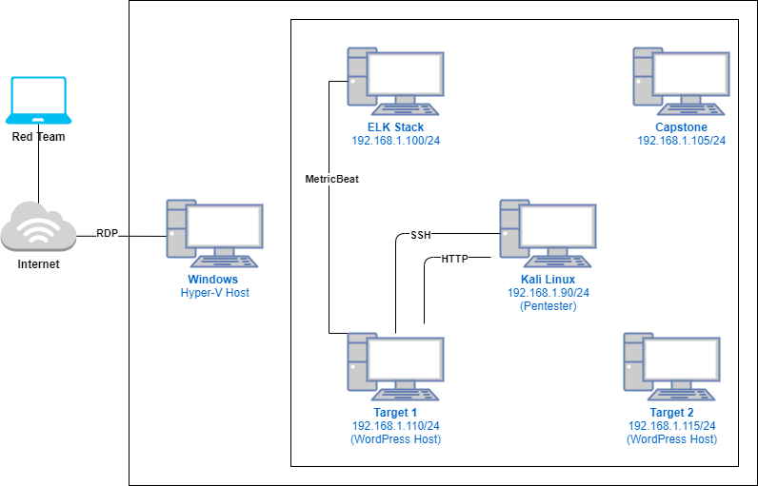
Network Topology
Network
Address Range: 192.168.1.0/24
Netmask: 255.255.255.0
Gateway: 192.168.1.1
Machines
IPv4: 192.168.90
OS: Kali Linux
Hostname: Kali
IPv4: 192.168.1.100
OS: Linux
Hostname: ELK Stack
IPv4: 192.168.1.110
OS: Linux
Hostname: Target 1
IPv4: 192.168.1.115
OS: Linux
Hostname: Target 2

Slide 5
Critical Vulnerabilities: Target 1
Our assessment uncovered the following critical vulnerabilities in Target 1.
Vulnerability | Description | Impact
Wordpress Username Enumeration CVE-2009-2335 | WUE is the process in which attackers remotely enumerate valid usernames for a defined attack surface. | This allows attackers to find valid username information based on failed login attempts. Many Vendors dispute the significance of this issue due to “user convenience” concerns.
Brute Force Vulnerability CVE-2020-14494 | A BFV consists of an attacker configuring predetermined values, making requests to a server using those values, and then analyzing the response. | This allows attackers to run values, such as passwords, through software that will guess predetermined strings until a favorable response returns.
Least Privilege Violation CWE-272 | A LPV is the concept that access should be allowed only when it is absolutely necessary to the function of a given system, and only for the minimal necessary amount of time. | Not implementing LPV results in sensitive information to be at risk for attackers to discover once in a system. In this case, read access to the wp-config.php file allowed our team to infiltrate the mySQL database for password hashes of current employees.
Privilege Escalation CWE-269 | A misconfigured sudoers file can allow root privilege loopholes given to binary programs. | Allowing root privileges to binary programs can give system users root access to the system without the need for a password.

Slide 6
Exploits Used
‹#›

Slide 7
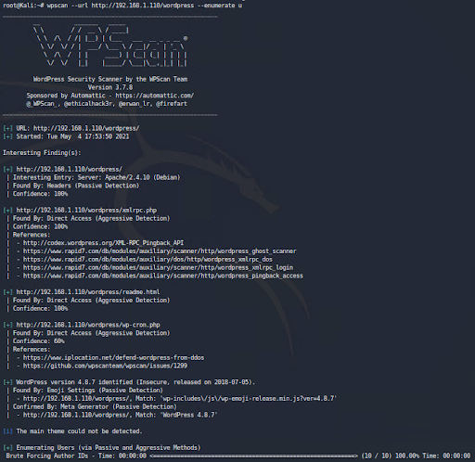
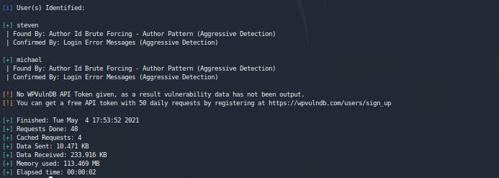
Exploitation #1: WordPress User Enumeration
Summarize the following:
How did you exploit the vulnerability?
wpscan –url http://192.168.1.110/wordpress/ -enumerate u, vp
What did the exploit achieve?
Critical information gained access to the server via SSH

Slide 8
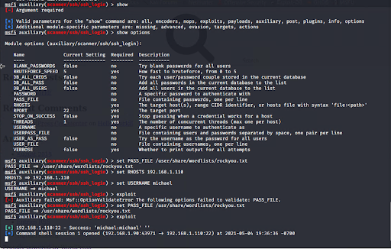
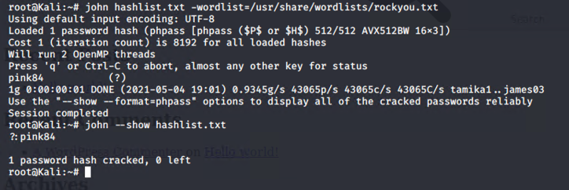
Exploitation #2: Brute Force Vulnerability
Summarize the following:
How did you exploit the vulnerability?
Manual brute force (weak password), metasploit scan to confirm michael’s password, MySQL database located unprotected hash + JohnTheRipper to crack steven’s password.
What did the exploit achieve?
Gained ability to ssh and privileges for steven & michael

Slide 9
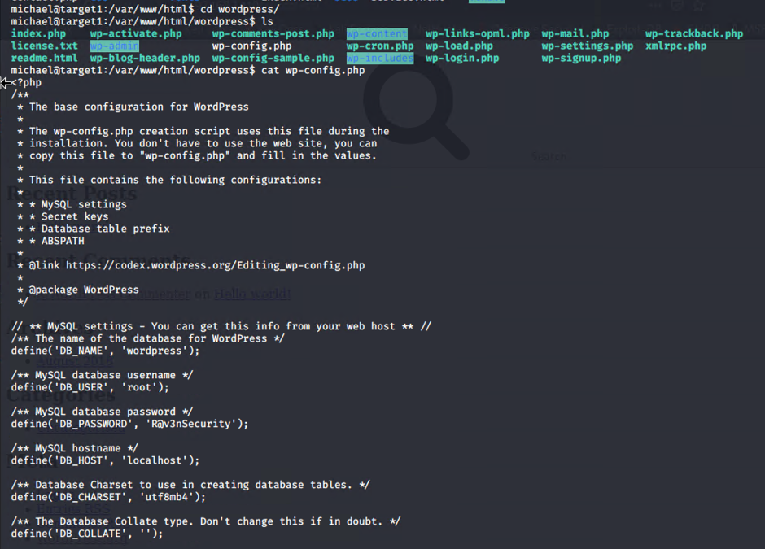
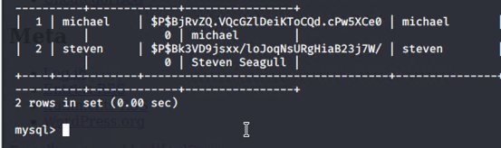

Exploitation #3: Least Privilege Vulnerability
Summarize the following:
User micheal was given read/write access to the wp-config.php file, which contained all plaintext passwords and usernames to the Raven Security mySQL database.
Through this access, we were able to retrieve the wp_user hash list of passwords for users michael and steven.
John the Ripper was used to crack user steven’s hash and retrieve his password: pink84
Restricting read/write privileges to the plaintext passwords and usernames contained within the Raven Security mySQL database would have prevented this exploit.

Slide 10
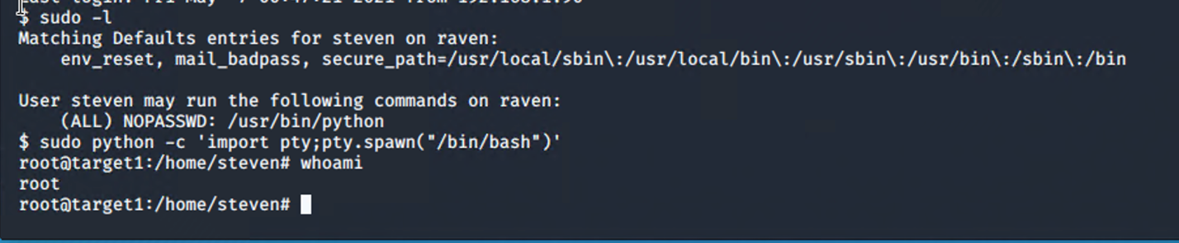
Exploitation #4: Privilege Escalation
Summarize the following:
How did you exploit the vulnerability?
use of sudo -l to gain information needed to perform escalation
sudo python -c ‘import pty;pty.spawn(“bin/bash”)’
What did the exploit achieve?
Using Steven’s sudo python access to escalate to root user access

Slide 11
Alerts Implemented
‹#›

Slide 12
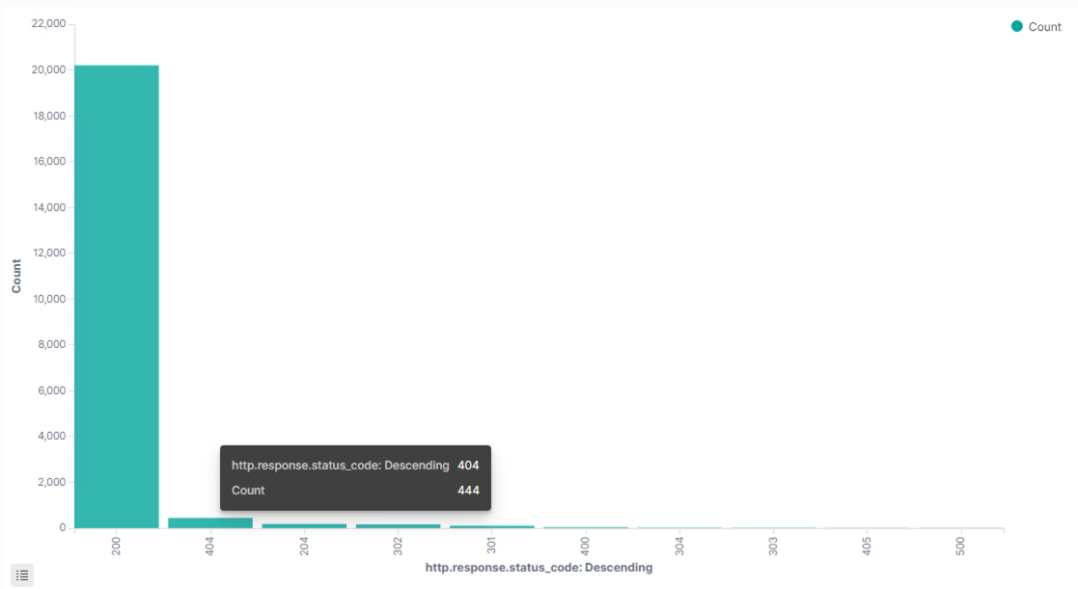
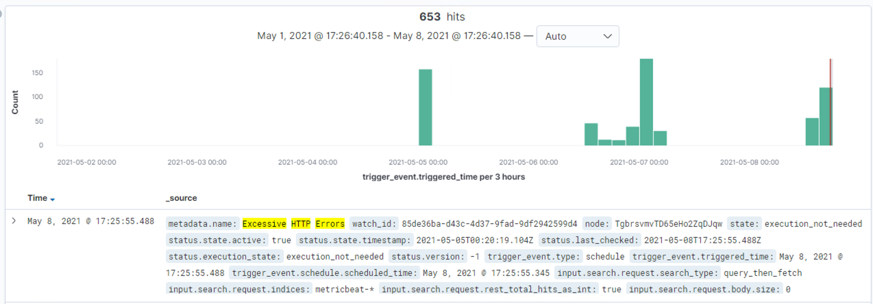
Excessive HTTP Errors
Metric: HTTP Response Status Code is Above 400
Threshold: Count exceeds Top 5
Vulnerability Mitigated: Malicious HTTP requests and excessive errors
Reliability: Low, no condition.met was triggered even with malicious HTTP traffic

Slide 13
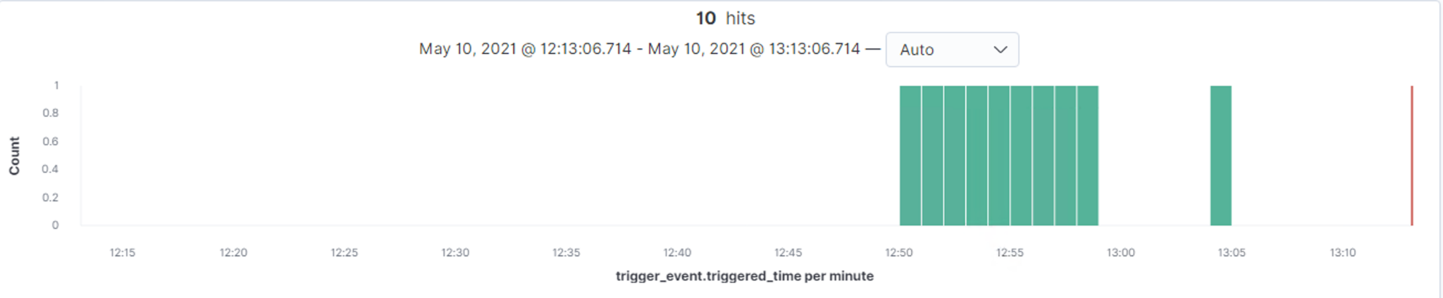
HTTP Request Size Monitor
Metric: HTTP Request Bytes
Threshold: Count Exceeds 3500 Bytes over all documents
Vulnerability Mitigation: Website Enumeration and Malicious Payload Posts
Reliability: Medium. This alert triggered during the website enumeration process. If a narrow focus is preferred, this rule would be graded a success.

Slide 14
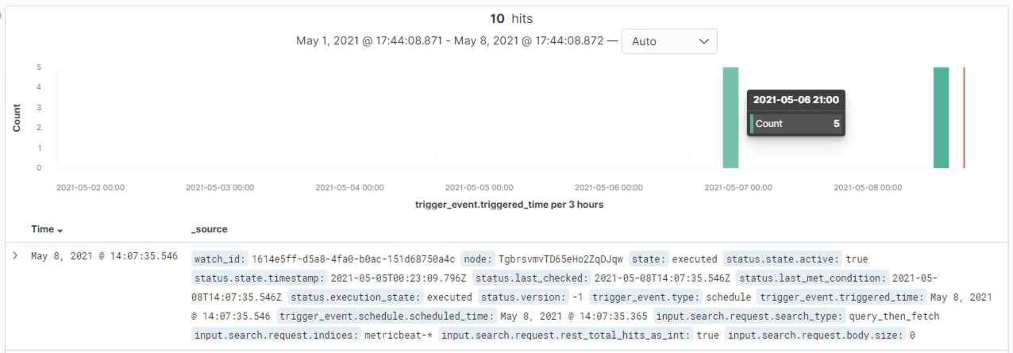
CPU Usage Monitor
Metric: System Process CPU Total Percentage
Threshold: Above 50%
Vulnerability Mitigated: Enumeration; Brute Force Attack
Reliability: High. This rule triggered several times over the course of our assessment during the local directory enumeration and the web page enumeration.

Slide 15
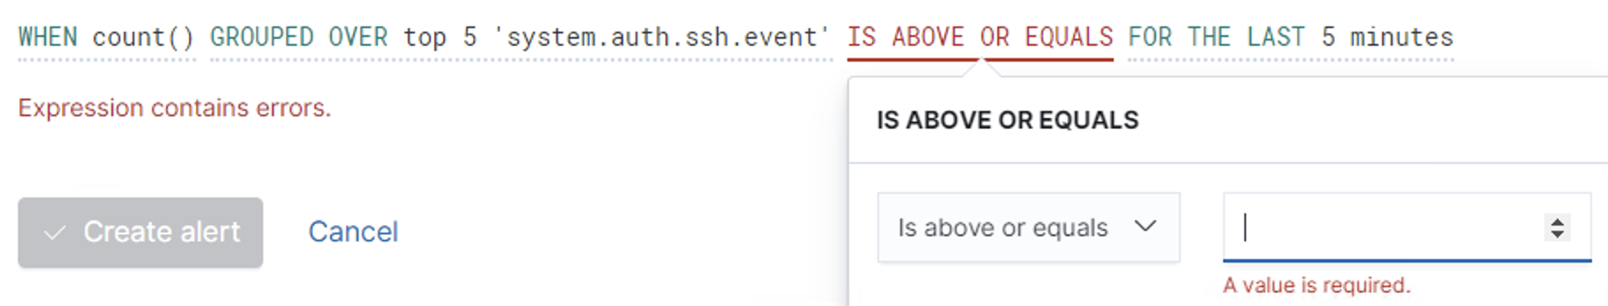
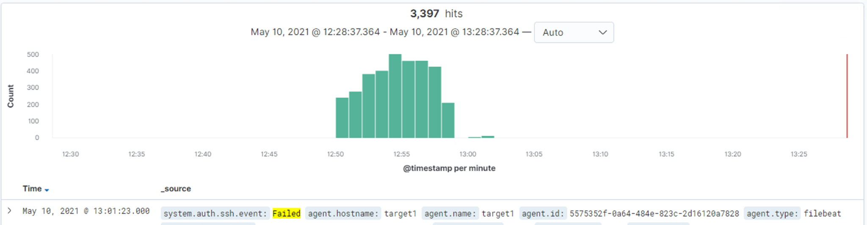
SSH Login Monitor
Metric: System Authentication Event Failed
Threshold: 5
Vulnerability Mitigated: Brute Force SSH Login
Reliability: High. This is a specific rule created to trigger in the event a malicious actor tries to brute force SSH Login information.
We were unable to create the threshold due to restrictions regarding the value field.

Slide 16

Hardening
‹#›

Slide 17
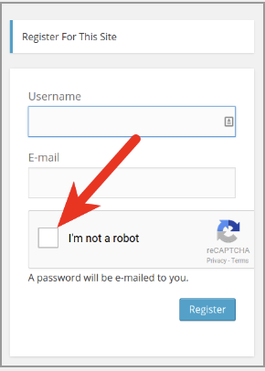



Hardening Against Wordpress Username Enumeration
Remove the vulnerable Wordpress page from the current working website
This is best accomplished through the wordpress GUI, but can also be accomplished by deleting the webpage in the website’s root directory
Install a Web Application Firewall and configure the settings to block Website Scans.
Popular Wordpress WAFs include: Sucuri,
maxCDN, and Cloudflare among others.
Implement reCAPTCHA into the login page
reCAPTCHA can be added to the website
via a wordpress plugin available in the
administration page.

Slide 18

Hardening Against Brute Force Vulnerability
Enforce a Strong Password Policy
Complex passwords 8-12 characters in length with at least one number and one symbol included.
Wordpress Two-Factor Authentication Plug-in
Popular Providers include Shield Wordpress Security, Google Authenticator, and Duo Two-Factor Authentication.
Restrict access to network via IP address access list
Uncomplicated Firewall
sudo ufw deny from xxx.xxx.xxx.xxx to any
iptables
sudo iptables -I INPUT -s xxx.xxx.xxx.xxx -j DROP
Firewalld
sudo firewall-cmd --permanent --add-rich-rule=”rule family-’ipv4’ source address=’xxx.xxx.xxx.xxx’ reject”

Slide 19
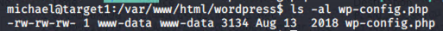

Hardening Against Least Privilege Vulnerability
Change the wp-config.php permissions to root access only to prevent non-administrative system users from reading the file.
Command: chmod 400 wp-config.php
Change the permissions on the entire wordpress folder to prevent non-administrative system users from accessing the contents of the website
Command: chmod -R 400 /var/www/html/wordpress/

Slide 20


Hardening Against Root Privilege to Binary Programs
Do not allow root privileges to binary programs, including the python programing language. Root access loopholes also exist on:
Perl, Less, Awk, Man, Vi, Env, FTP, SCP, and many others.
If a user needs to execute a script with sudo privileges, grant them time restricted access by adding the path to the sudoers file or create a separate group for individuals who need this access. Commands:
Editing the sudoers file
sudo visudo
steven ALL = (root) NOPASSWD: /usr/bin/python
delete this from the file after the project is complete
%developers ALL = (root) NOPASSWD: /usr/bin/python
Audit this group regularly to ensure the principle of
least privilege
Adding/Deleting users to a group
sudo usermod -aG developers steven
To add steven to the group
sudo usermod -G steven steven
To remove steven from the group

Slide 21
Network Traffic Analysis
‹#›

Slide 22
Traffic Profile
Our analysis identified the following characteristics of the traffic on the network:
Feature | Value | Description
Top Talkers (IP Addresses) | 172.16.4.205(49.36%), 185.243.115.84(29.16%), 10.0.0.201(18.74%), 166.62.111.64(15.11%) | Machines that sent the most traffic.
Most Common Protocols | HTTP, TCP, UDP, TLS, DNS | Three most common protocols on the network.
# of Unique IP Addresses | 808 IPv4, 2 IPv6 | Count of observed IP addresses.
Subnets | 10.0.0.0/16, 10.11.0.0/16, 172.16.0.0/16, 192.168.0.0/16, 185.243.0.0/16, 166.62.0.0/16 | Major Observed subnet ranges.
# of Malware Species | 2 | Number of malware binaries identified in traffic.
Notes:
You may have more than 2 subnets.

Slide 23
Behavioral Analysis
Purpose of Traffic on the Network
Users were observed engaging in the following kinds of activity.
“Normal” Activity
General Web Browsing
DNS Controller Communication
Suspicious Activity
Watching Excessive YouTube During Work Hours
Using Torrent to Download Materials
Surfing Malicious Sites (malware host)
Device Cracking

Slide 24
Normal Activity
‹#›

Slide 25
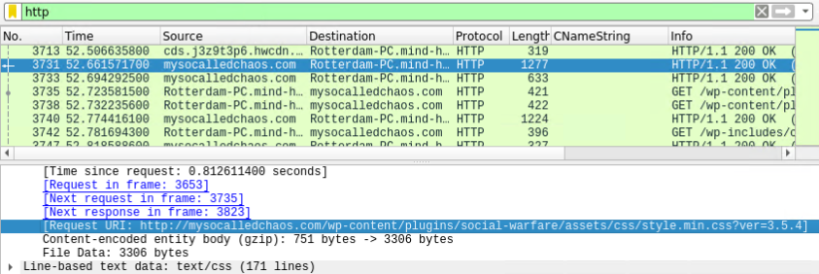

Browsing the Web
Summarize the following:
We observes HTTP traffic to many sites on the network
Some examples are sites like mysocalledchaos.com, a popular blog about family life run by a mother

Slide 26
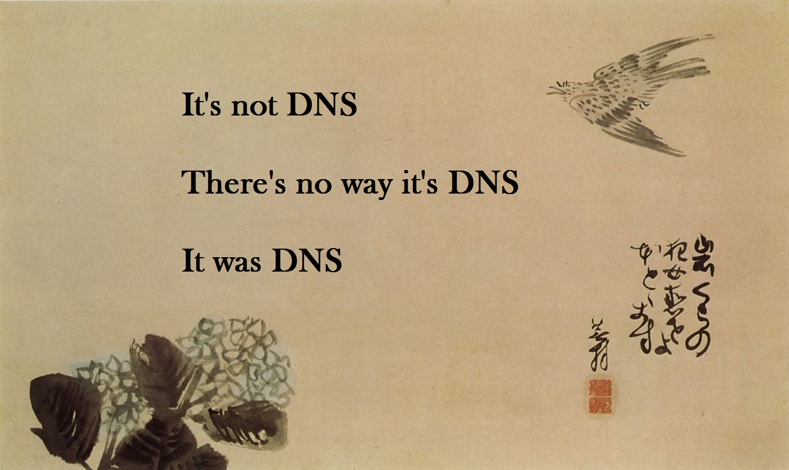
DNS Controller Communication
We witnessed many calls to and responses from DNS servers on the network
We could see requests and responses like the one below between okay-boomer-dc and Roger-MacBook-Pro

Slide 27
Malicious Activity
‹#›

Slide 28
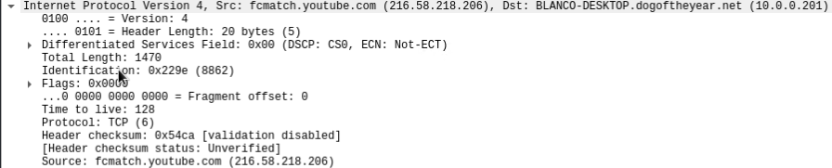

Watching Excessive YouTube During Work Hours
By request of X-CORP we investigated the excessive viewing of youtube during work hours
We found that several users were spending much of their time and resources during work hours binge watching youtube

Slide 29
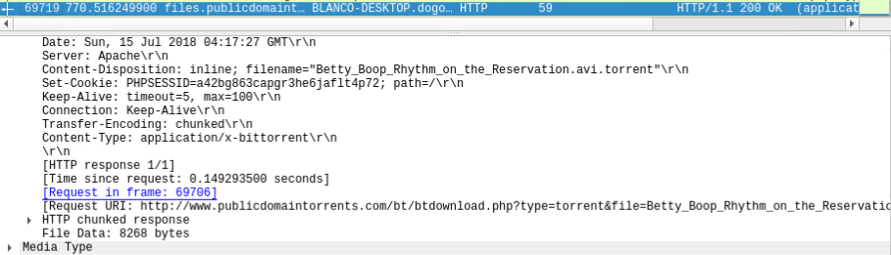

Using Torrent to Download Materials
We observed the downloading of torrent files
Specifically, we found a user downloading classic cartoons on the company network

Slide 30

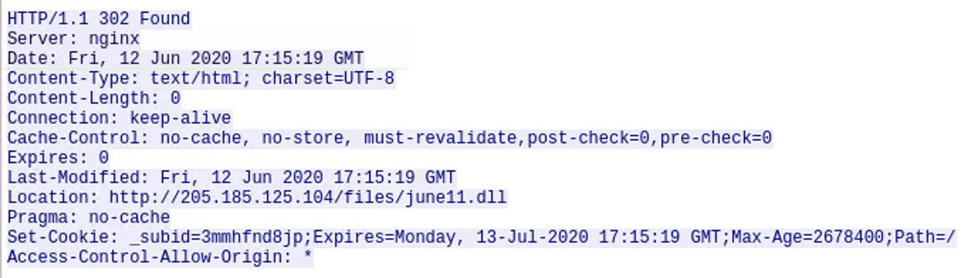
Surfing Malicious Sites (malware host)
Summarize the following:
It was found that a user visited a site which directed them to download malware.
Specifically, the user had downloaded a file called june11.dll, a trojan virus that likely infected the user’s computer
the june11.dll trojan malware originated from http://205.185.125.104/files/june11.dll

Slide 31
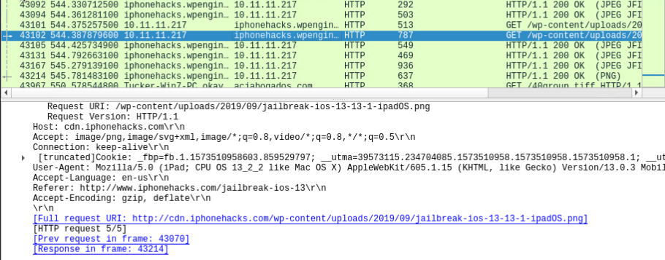

Device Cracking
We observed traffic that suggested a user was researching or even in the process of jailbreaking a device
There were packets to and from cdn.iphonehacks.com

Slide 32

Conclusion + Thank You James & Jairo

Slide 33
Activity File
To access the activity file with which this presentation was created, follow this link here:
https://docs.google.com/document/d/1WbxlmU40Y8_R327voUeqnDoD1TBurLxL1wIpDr0etW0/edit?usp=sharing

